Slide 1

Implementing row-level security in Power BI

Slide 2
Implementing row-level security (RLS)
Implementing Row-Level Security (RLS) in Power BI is a powerful feature that restricts data access at the row level, allowing users to view only the data relevant to them. RLS is useful for maintaining data confidentiality and improving user experience by limiting the visible data to each user based on roles and permissions.

Slide 3

Steps to implement row-level security in Power BI
1. Define Roles in Power BI Desktop
In Power BI Desktop, go to Modeling > Manage Roles.
Create a new role and set filters on tables by specifying DAX expressions that define access rules ([Region] = "East“) to restrict data to a specific region).
Multiple roles can be defined if different user groups require distinct data views.

Slide 4
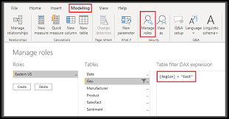
2. Assign users to roles in Power BI service
Publish your report to Power BI Service.
Go to the dataset’s settings in Power BI Service, select Security, and assign specific users or security groups to each role.
Only the assigned users will see the data allowed by their roles.

Slide 5

3. Test security settings
In Power BI Desktop, use the View as Role feature to verify the RLS setup.
In Power BI Service, you can test the roles by selecting Test as Role to ensure each role restricts data correctly for different users.

Slide 6
Key points to consider
Dynamic RLS: You can implement dynamic RLS by linking user information with data in the model (e.g., mapping usernames to regions). This can be done by using USERPRINCIPALNAME() to identify the current user.
Security on Import or Direct Query Mode: RLS works with both Import and Direct Query mode, but the setup may vary slightly based on the data source.
Limitations: RLS is not available in Power BI Pro for datasets accessed via a live connection to Analysis Services. Additionally, RLS only restricts data access in Power BI reports and dashboards, not in exported or shared content outside Power BI.

Slide 7
Conclusion
RLS setup in Power BI is straightforward, allowing roles and rules to be configured with flexibility, whether through static or dynamic conditions. However, testing roles and understanding limitations—such as compatibility with specific data sources and sharing restrictions—are crucial for effective deployment. Overall, RLS in Power BI is a powerful mechanism for tailoring data access, fostering secure data sharing, and enabling a focused and user-specific data experience.

Slide 8
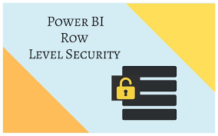

Thank you
ajaycraju98@gmail.com

